Slide 1
GameCo 2017 Marketing Analysis Project
Justin Kim

Slide 2
Hypothesis
The current understanding of GameCo's marketing strategy is that the main regions GameCo focuses on (NA, EU, and JP) have maintained consistent sales each year; thus, the marketing budget has remained steady.

Slide 3
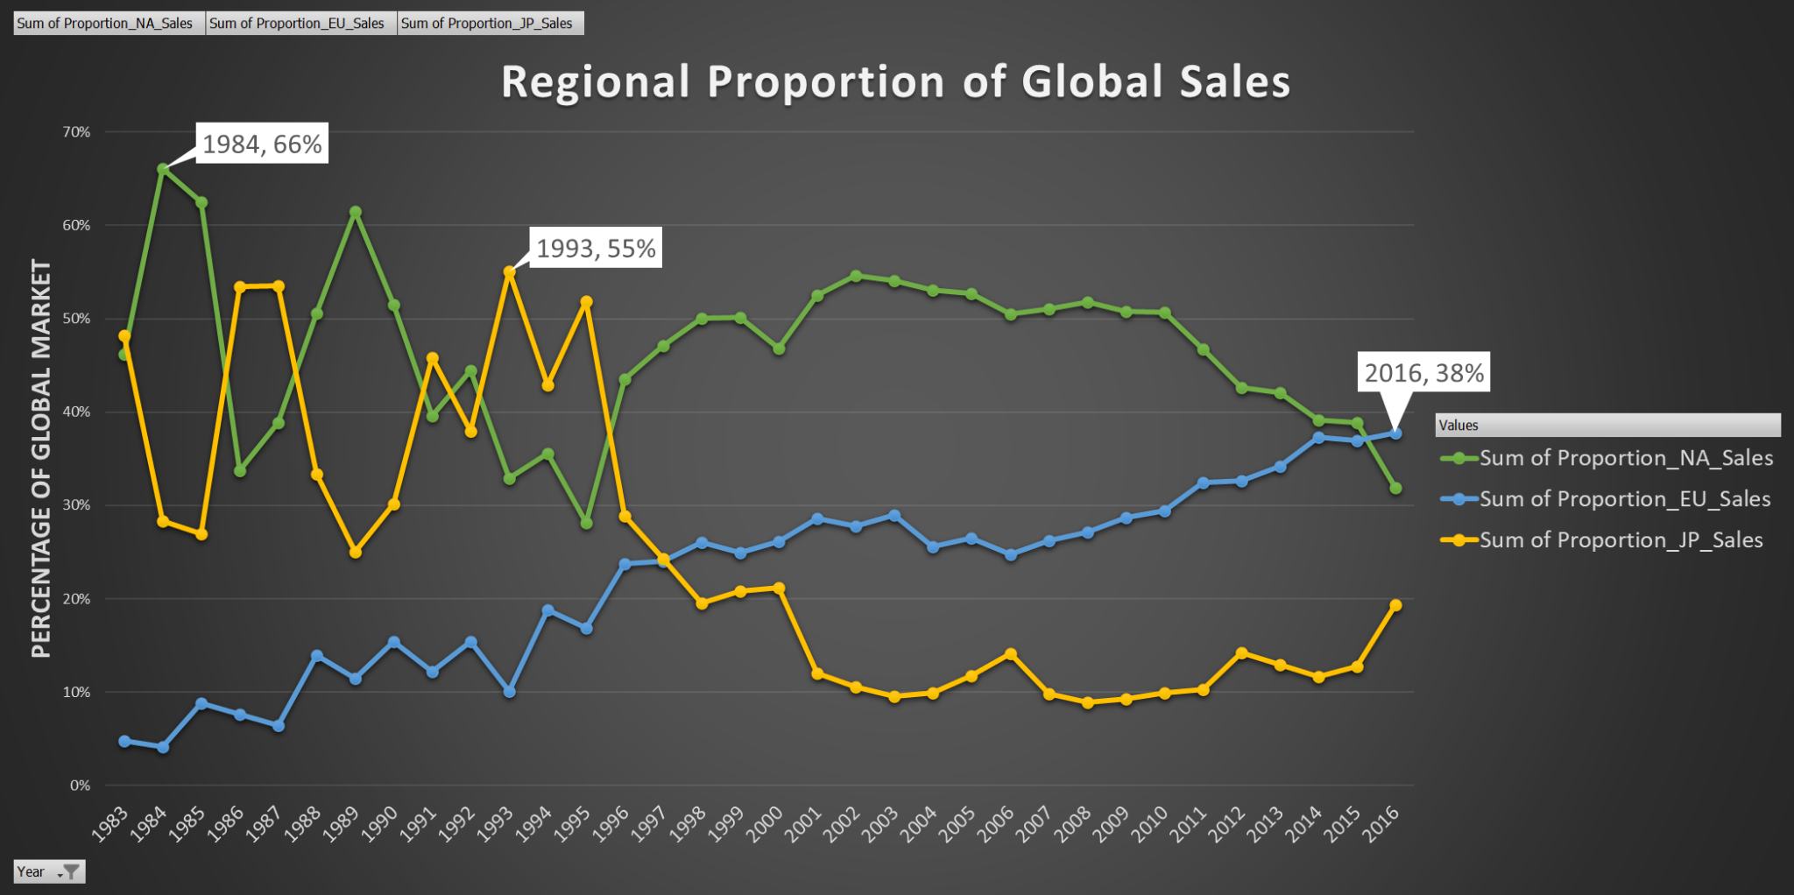
Data on GameCo Global Sales by Region
Insights
The NA market has significantly dropped from its initial 66% proportion of global market sales
In 2016, EU emerged as the top region with 38% of global market sales
Despite JP being the lowest region in 2016, it is on a steady incline.
*The data here suggests that each region has substantially changed in its global sales proportion over time.

Slide 4
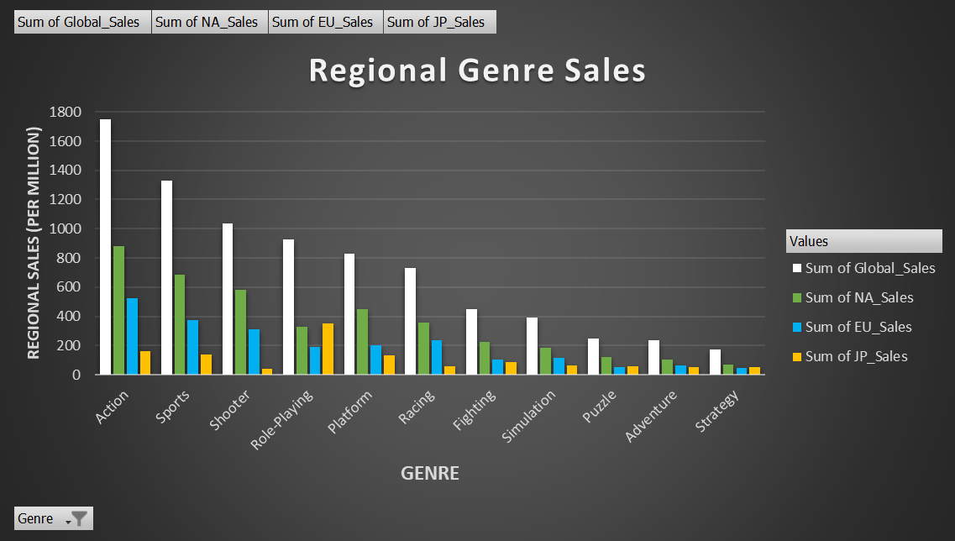
Data on GameCo Genre Sales by Region
Insights
JP sales exceed EU and NA in the Role-Playing Genre
Top 3 genres in global sales ( Action, Sports, and Shooters) each exceed 1,000 million units

Slide 5
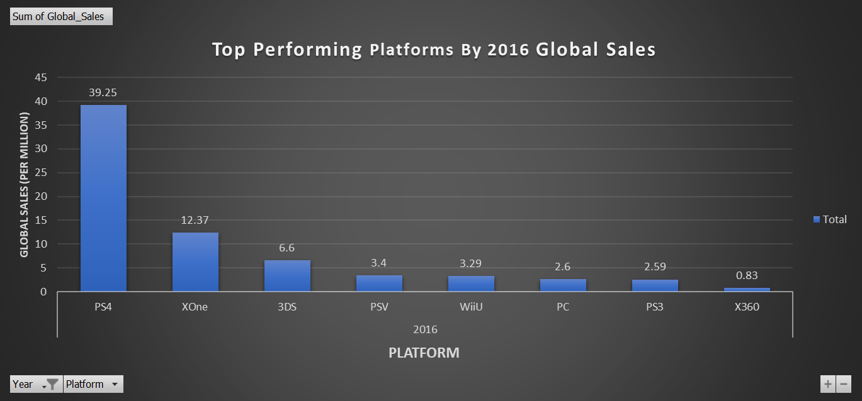
Data on GameCo Platform Sales in 2016
Insights
The Playstation 4 performed the highest in global sales with 39.25 million units.
The PC platform performed below Sony, Microsoft, and Nintendo Consoles
Handheld consoles (3DS and PSV) placed in the top 5 platform global sales.

Slide 6
2017 GameCo Marketing Wrap Up
The data analysis suggests that the initial hypothesis was incorrect, and the data shows that the sales for each region has changed significantly over time.
Regional Sales have changed over time
Recommendation
Allocate less resources in NA ( focus just on top genres)
Allocate more resources in EU region
Monitor the trends and releases from Japanese game developers
It is clear the top performing genres are consistent throughout each region
Recommendation
Focus marketing resources towards Action, Shooter, and Sports Titles ( top 3 global sales)
Place more resources towards role-playing games in the JP region
The Playstation 4 is the top performing console in 2016
Recommendation
Increase marketing resources towards upcoming PS4 titles
Allocate a small percentage of marketing resources towards the handheld consoles (PSV and 3DS)

Slide 7
Upcoming Trends
The next console wars, and the rise of

Slide 8
Thank You
Questions?

